Slide 1
TLP – part 1
Kirill Korolev
12.04.2021

Slide 2
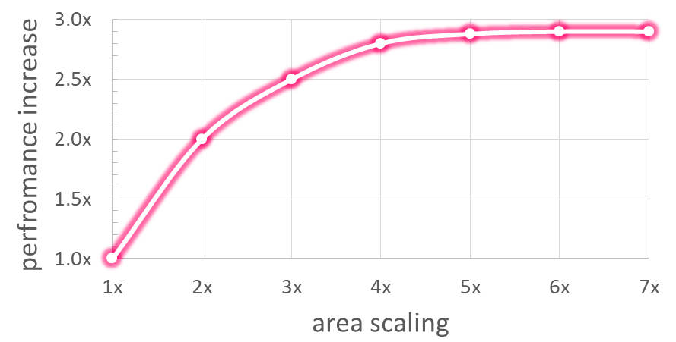
Motivation
Superscalar is hard to scale:
ILP is depleted – all independent instruction are already executed in parallel
Inefficient – power & area grows faster than performance
Alternative way to use area is Multicore:
1 big core - 6x area with 3x performance
3 small cores (2x area & performance each) - 6x area with 6x performance boost in total
2x efficiency!

Slide 3
Thread-level parallelism
Running tasks can be separated into independent execution threads
multiple applications running simultaneously
from a single application – parallelized by a programmer
Single-core CPU utilizes instruction-level parallelism (ILP) of 1 thread
Multicore utilizes thread-level parallelism (TLP)
Each thread is executed on single core

Slide 4
Types of multiprocessors
All processors works with one address space
SMP — Symmetric Multi Processing
Identical processing units with a single shared memory
Fast and effective memory usage
Low scalability due to lots of interconnections and limited memory throughput
NUMA — Non Uniform Memory Access
Each processing unit with its own memory and shared memory bus
Highly scalable
Requires special coherency protocols and OS support

Slide 5
Multiprocessor vs Multicore
Multiprocessor: sharing memory on CPU level
Original approach
Good for independent workloads
Bad for cooperative workloads with data exchange
Multicore: sharing memory between cores of 1 CPU
More advanced approach on a single chip
Shared cache and memory bus
Data exchange through the shared cache
CPU 1
CPU 2
Memory
CPU
core 1
core 2
Cache
Memory

Slide 6
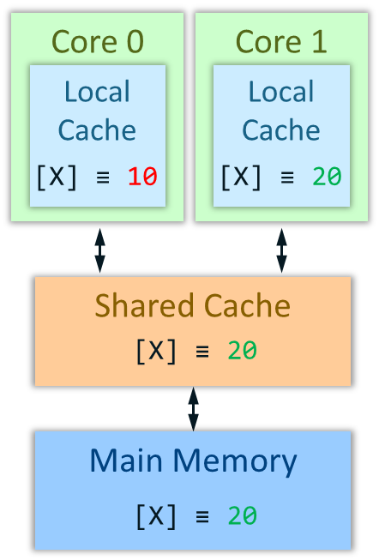
Memory Coherence in a multicore system
Each core has its own local cache
Cores can keep multiple local copies of the same data
Multiplied data can be damaged if one core modifies it:
Core 0
Core 1
Local
Cache
Local
Cache
hit
[X] ≡ 10
[X] ≡ 20
Memory: Mem[X] ≡ 10
Core 0: a = Mem[X] # a = 10
Core 1: Mem[X] = 20
Core 0: b = Mem[X] # b = 10
miss
Shared Cache
20
[X] ≡ 10
miss
Error: read the old value from the local cache
Main Memory
Memory must be coherent:
All cores must see memory identically
All cores must see the latest state of memory
20
[X] ≡ 10

Slide 7
Coherence protocols: MESI
Coherence protocols describe how to handle writes/reads to maintain memory coherence in a multicore system
Example: MESI protocol
Define 4 states of a cache line
Describe transactions between states
State rules:
To modify a line, ownership should be obtained first
There is no state when a line is modified and contained by other cores
 | Valid? | Owned? | Modified?
Invalid | NO | NA | NA
Shared | YES | NO | NO
Exclusive | YES | YES | NO
Modified | YES | YES | YES

Slide 8
MESI: example
Memory: Mem[X] ≡ 25
Core 0: a = Mem[X] # a = 25
Core 0: Mem[X] ≡ 35
Core 1: b = Mem[X] # b = 35
Snoop [X]
Core 0 writeback [X]
Core 1: Mem[X] ≡ 45
Request ownership for [X]
Core 0 invalidate [X]
Core 0
Core 1
Local
Cache
Local
Cache
[X] ≡ 25
[X] ≡ 35
[X]
[X]
35
[X]
45
S
35
I
E
M
S
M
Shared Cache
[X] ≡ 25
35
(1, 0)
(1, 1)
(0, 1)
Main Memory
[X] ≡ 25
[X] ≡ 25

Slide 9
MESI State Diagram
request ownership
request ownership
snoop
snoop
read
Invalid
read shared
Shared
read
snoop
request ownership
snoop
write
snoop
request ownership
read not shared
write
request ownership
write
Exclusive
Modified
write
read
read
write

Slide 10
Thank You

Slide 11
Synchronization
Parallel cooperative tasks with common data require synchronization mechanisms
Synchronization is implemented with atomic operations
Ability to read and modify memory atomically
E. g. semaphores, MutEx (mutual exclusion), shared memory
Hardware support: atomic exchange
Includes 2 special memory instructions: Load Linked and Store Conditional
; exchange R4 and 0(R1):
try: MOV R3, R4
LL R2, 0(R1)
SC R3, 0(R1)
BEQZ R3, try
MOV R4, R2
SC returns 1 to R3 only if 0(R1) was not changed after LL to 0(R1)

